Slide 1
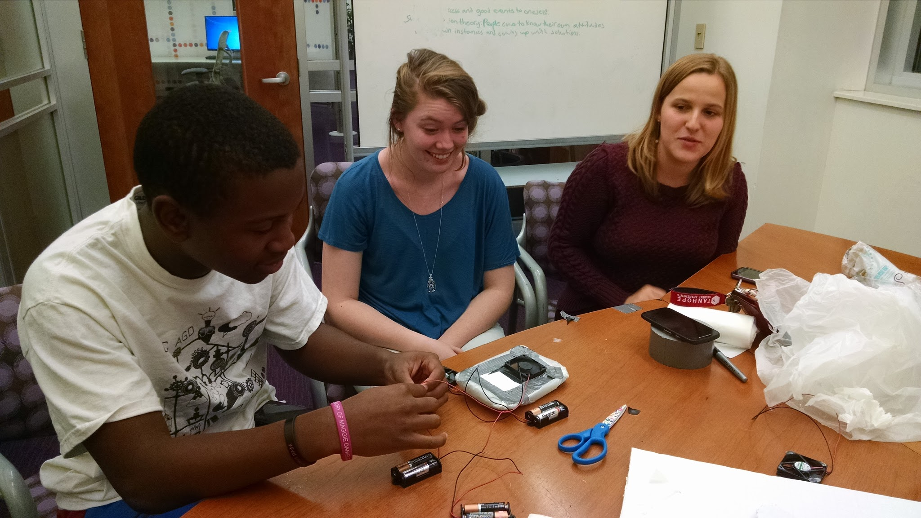
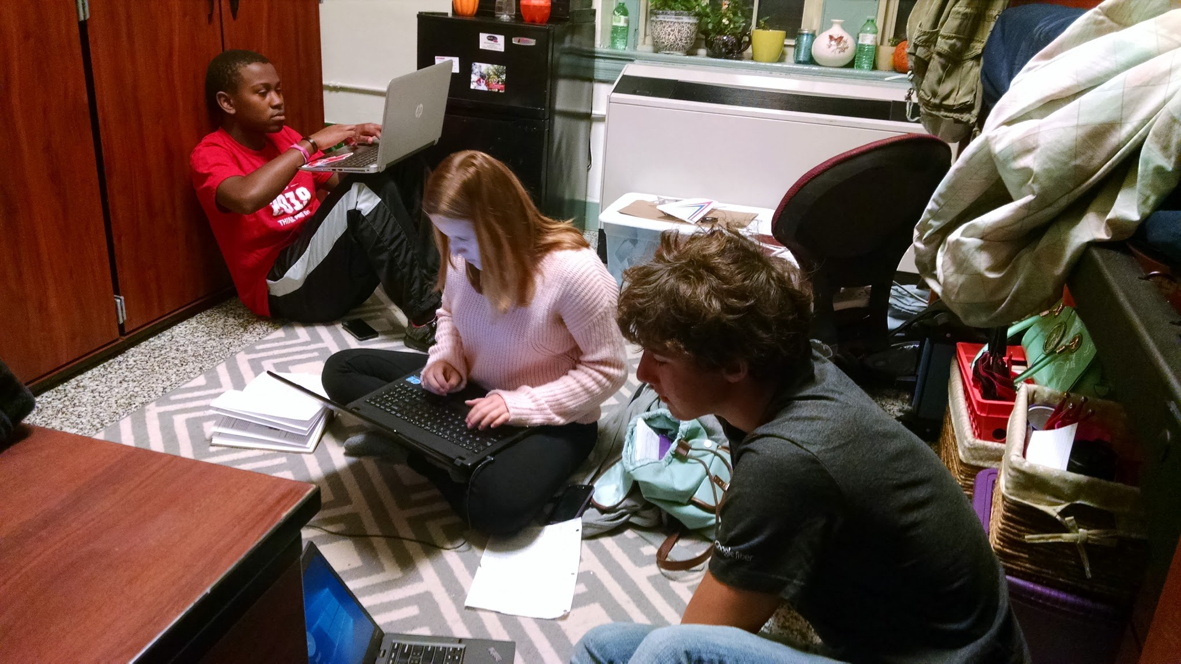
Hovercraft: The Journey
Noah Prezant
Maggy Wielgus
Jordan Hatch
Marques Miles
By: Jordan Hatch, Marques Miles, Maggy Wielgus, and Noah Prezant
Notes:
Look at this in powerpoint mode instead.

Slide 2
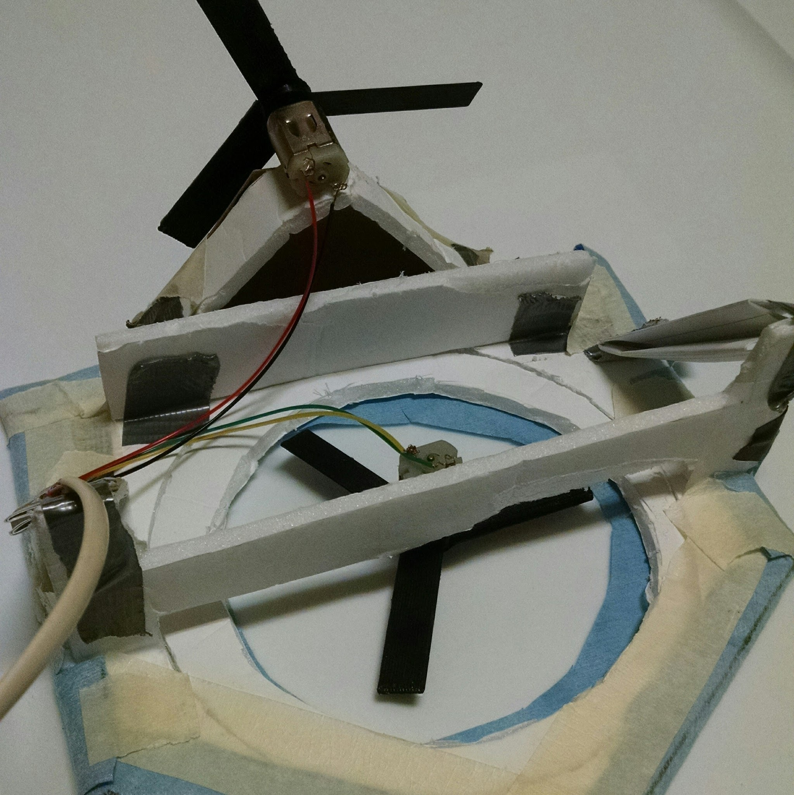
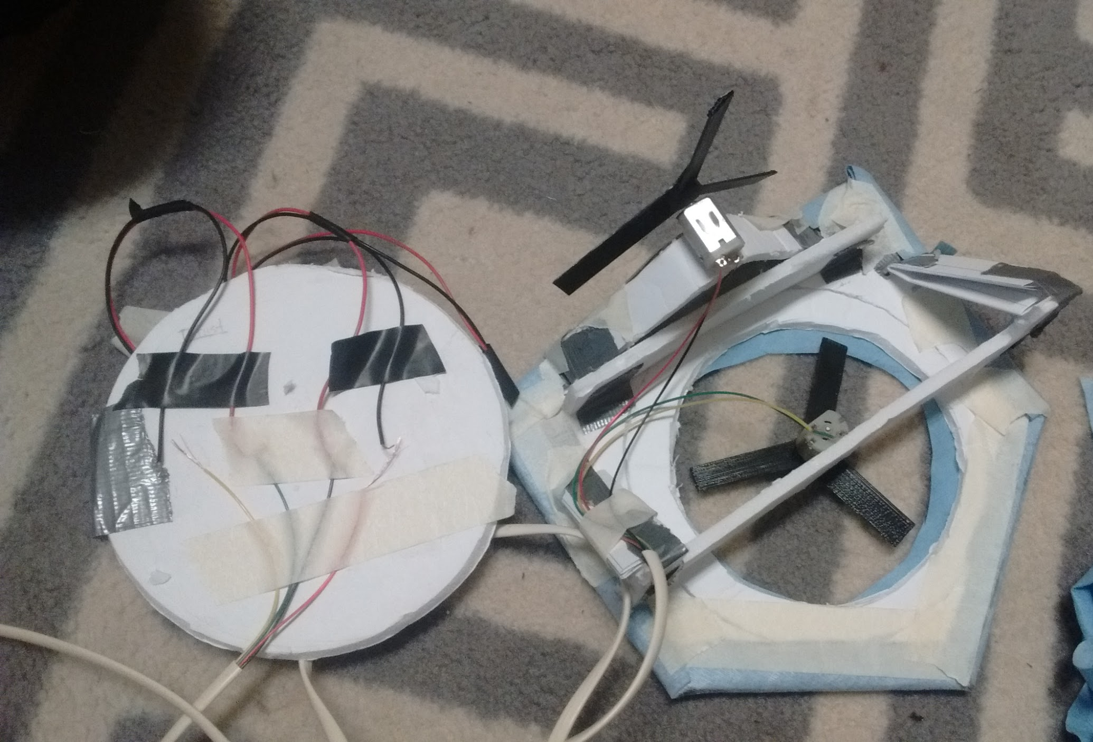
Final Product

Slide 3
Faced With...
Creating a hovercraft that navigates a straight 40ft course in the shortest time possible,
Using less than $40,
without commercially available hovercraft or plane or helicopter kits,
or gasoline.

Slide 4
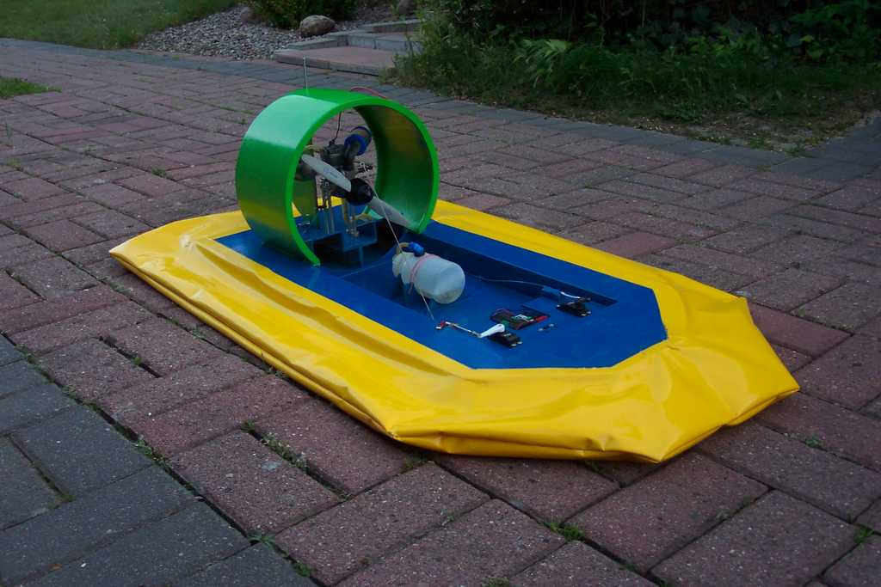
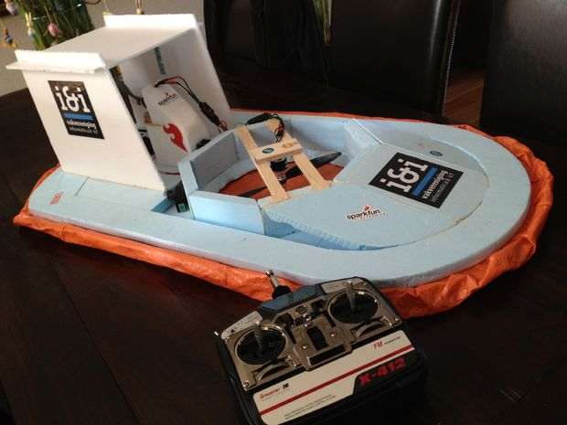
In the Beginning
We had glorious visions of hovercraft of the likes of
or

Slide 5
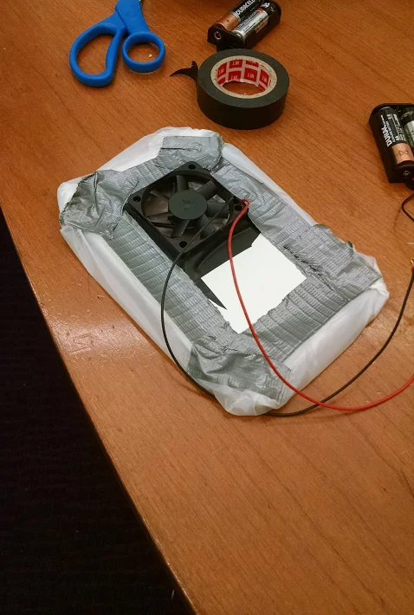
In Reality
Building a hovercraft is challenging... so, we started with one like this.

Slide 6
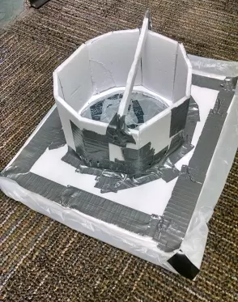
Challenges
Providing enough lift to allow the thrust to enact upon the hovercraft with minimal drag
Providing enough thrust to move with any notable speed
Coming to a consensus on which design would work the best

Slide 7
We Learned...
Besides how to build a hovercraft,
How to collaborate effectively to achieve a common goal
As a group composed of people who normally think through problems and succeed the first time, we learned how to fail and accept the importance of creating multiple prototypes
The convenience and usefulness of resources available on campus

Slide 8
Final Product

Slide 9
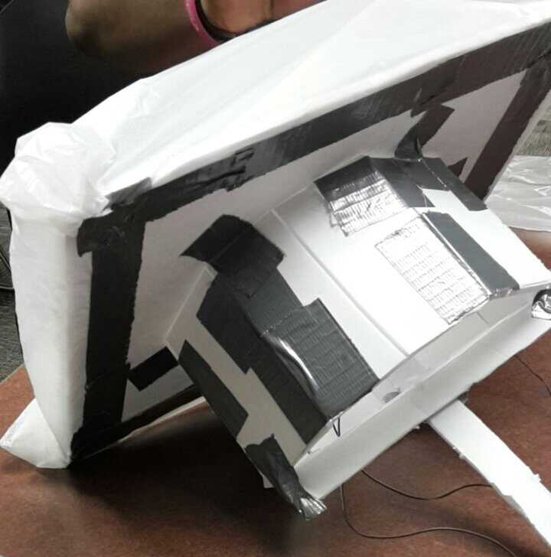

Slide 10
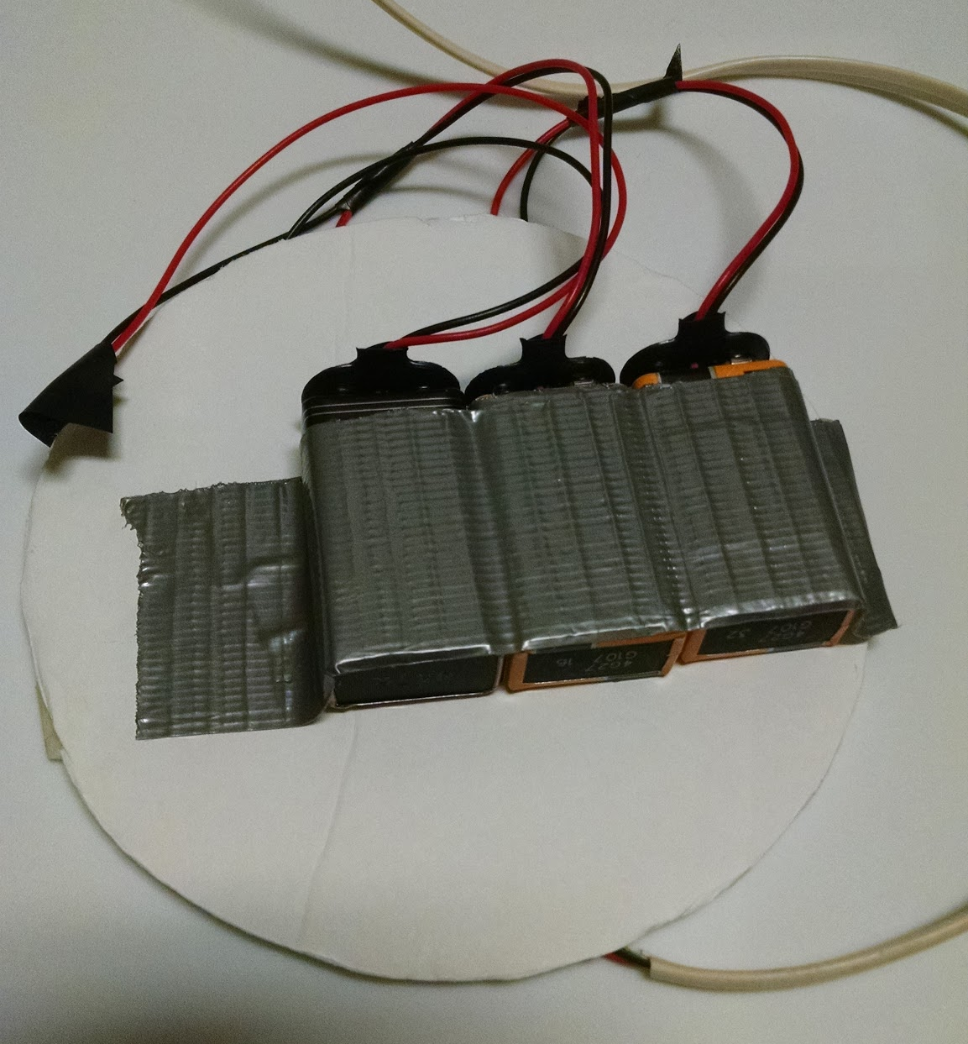

Slide 11
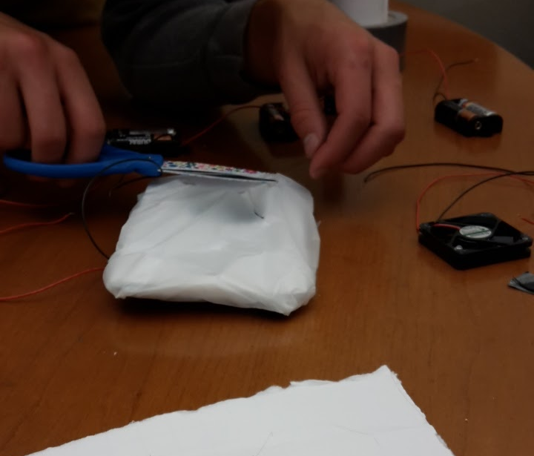

Slide 12
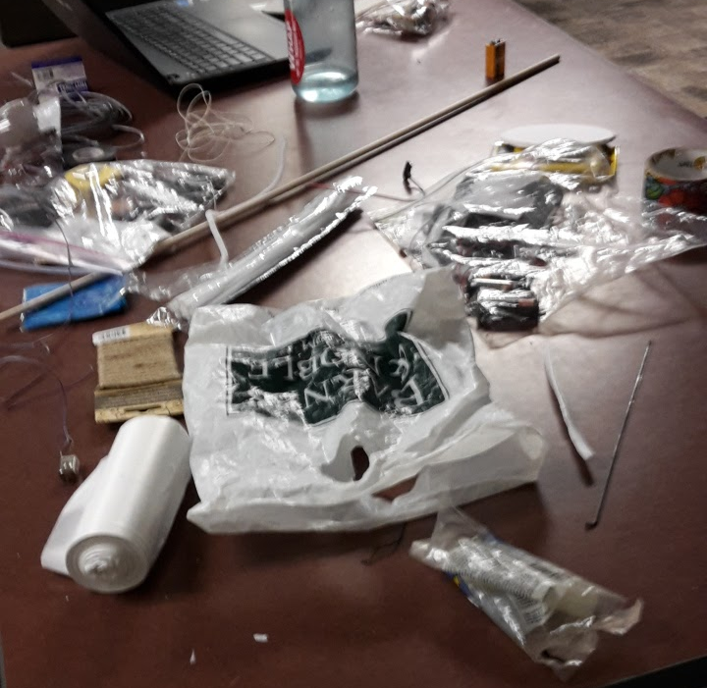

Slide 13
